Slide 1
E-Book Application System Integration (E.A.S.I.)
Seraphim

Slide 2
Clients
Our Clients:
Ms. J’aimé Pfeiffer (Capital Region BOCES)
Ms. Jen Cannell (Questar III)
Guests
Dr. Meg Fryling
Dr. Darren Lim

Slide 3
Introductions
Daniel Street: Team Leader
Lauren Mathews : Web Master
Nicholas Roth: Database Manager
Kevin Mango: Development Director
Tyler Carpenter-Rivers: Document Analyst

Slide 4
Problem Overview
Seraphim’s clients, Ms. Jen Cannell and Ms. Jaimé Pfeiffer, are in need of a single sign-on system for students to access and download e-books from their district’s libraries.

Slide 5
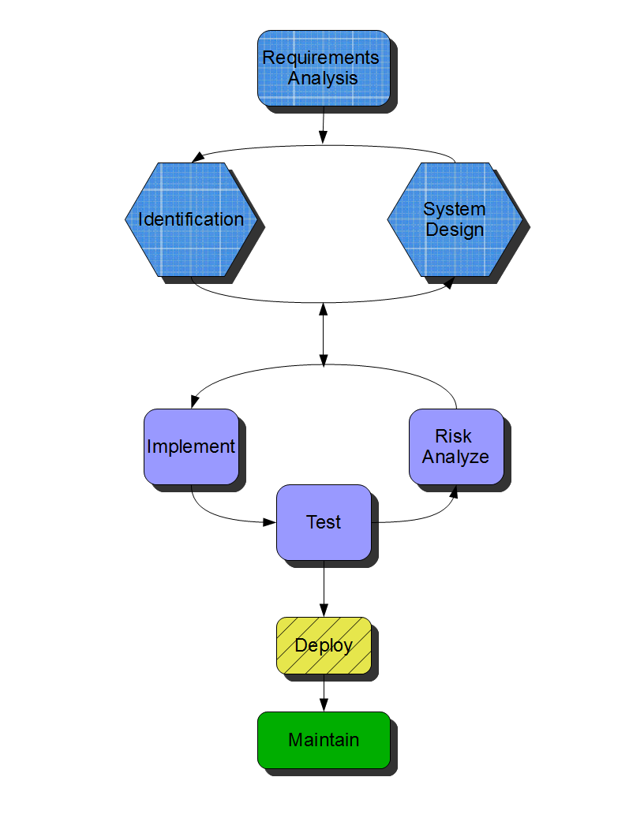
Spiralfall

Slide 6
Activity Diagram - Withdraw

Slide 7
DFD – Level 1 - Withdraw

Slide 8
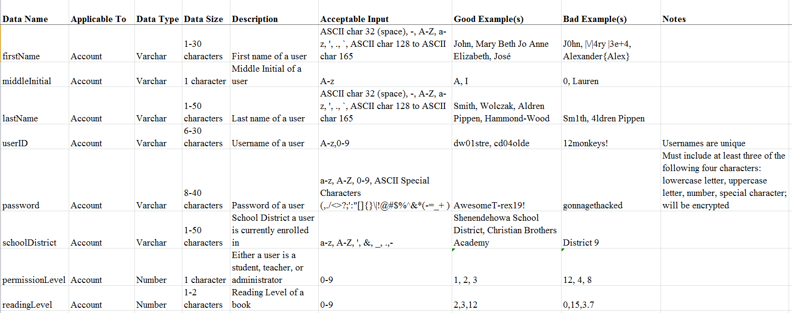
Data Dictionary

Slide 9
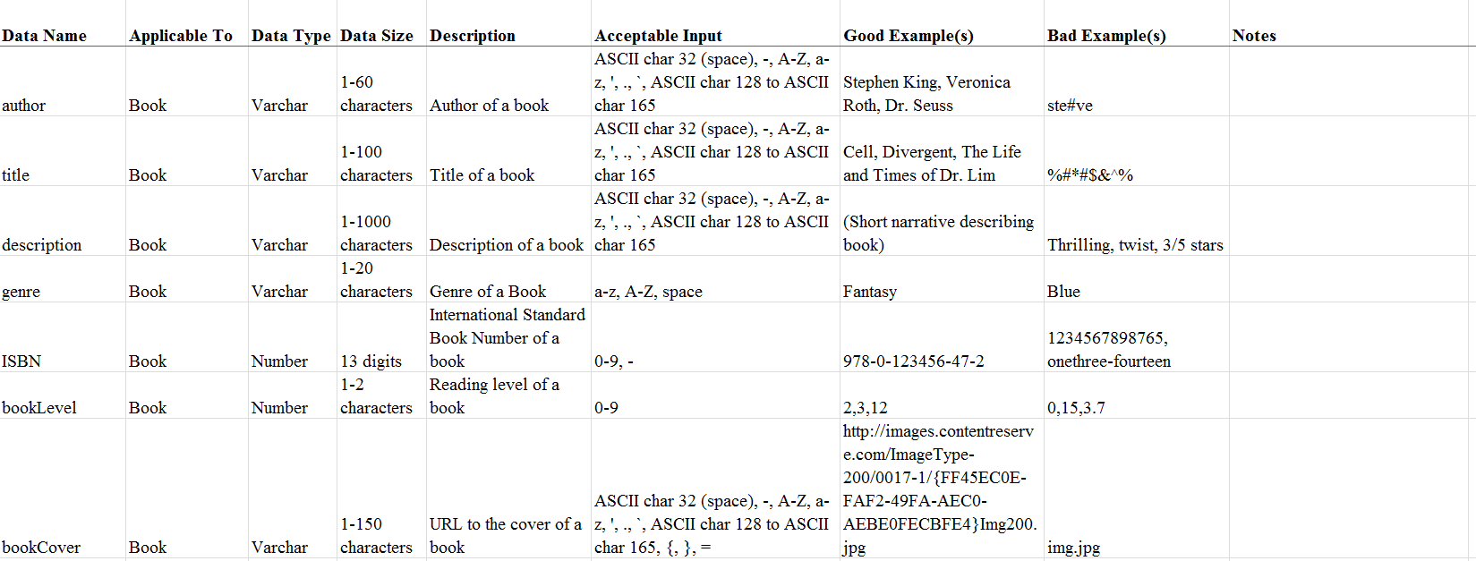
Data Dictionary – cont.

Slide 10
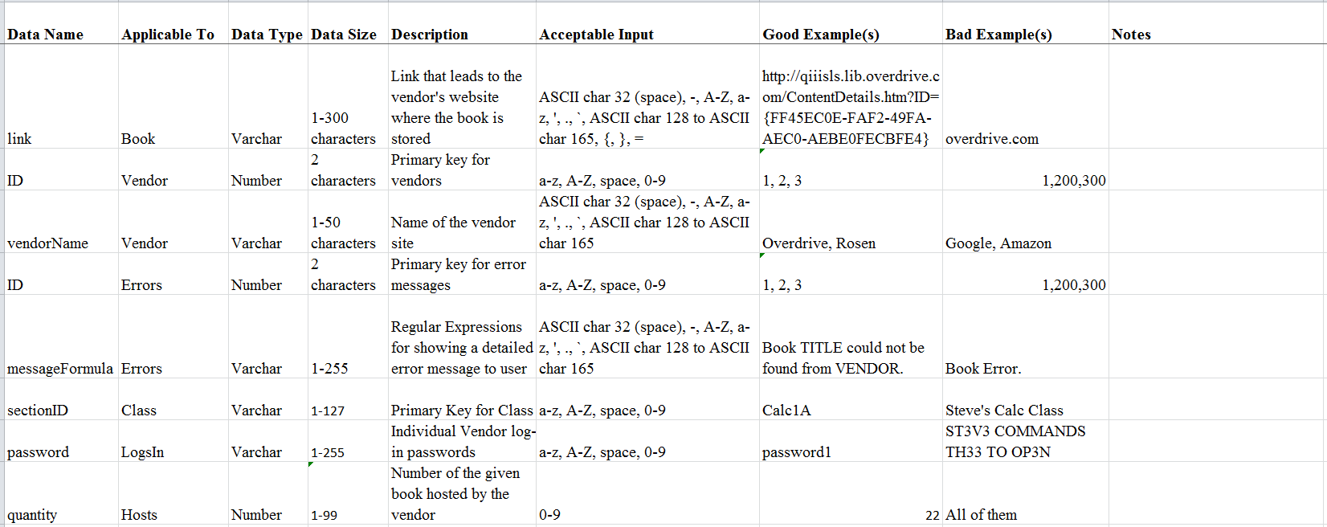
Data Dictionary – cont.

Slide 11
Data Dictionary – cont.

Slide 12
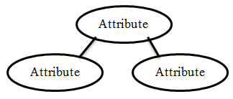
Entity-Relationship - Legend
Has
Name
Data Entity
Relationship
Composite Attribute
Attribute
Attribute
Attribute
Primary Key

Slide 13
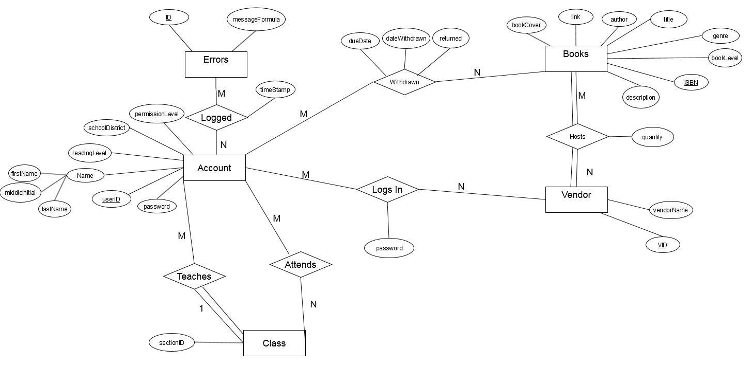
Entity-Relationship Diagram

Slide 14
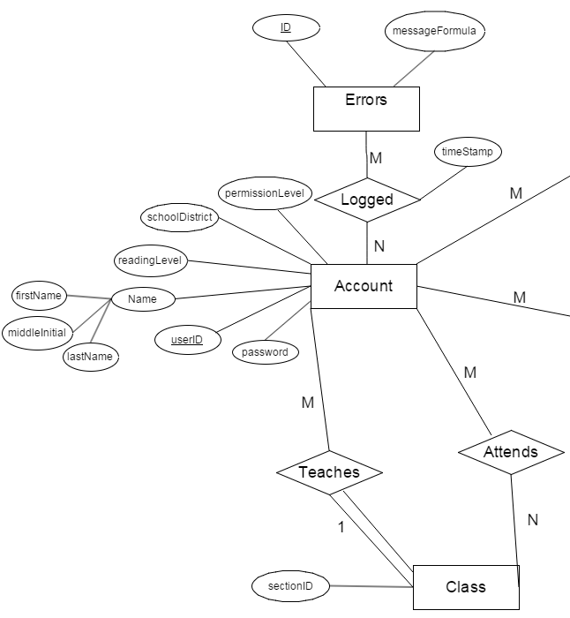
ER Diagram - Left

Slide 15
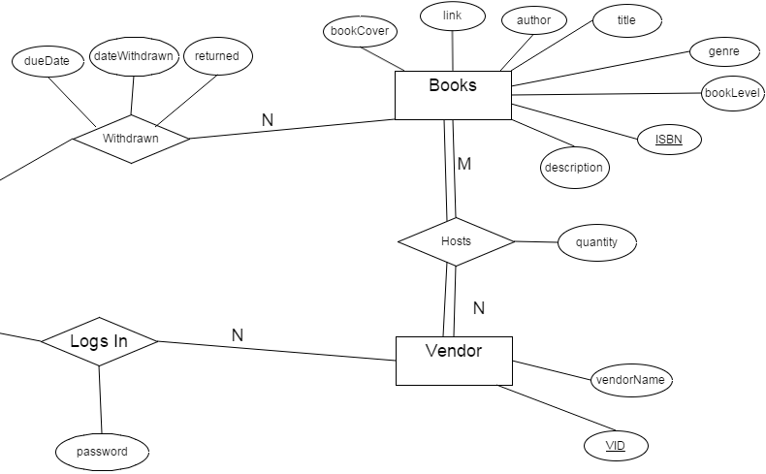
ER Diagram - Right

Slide 16
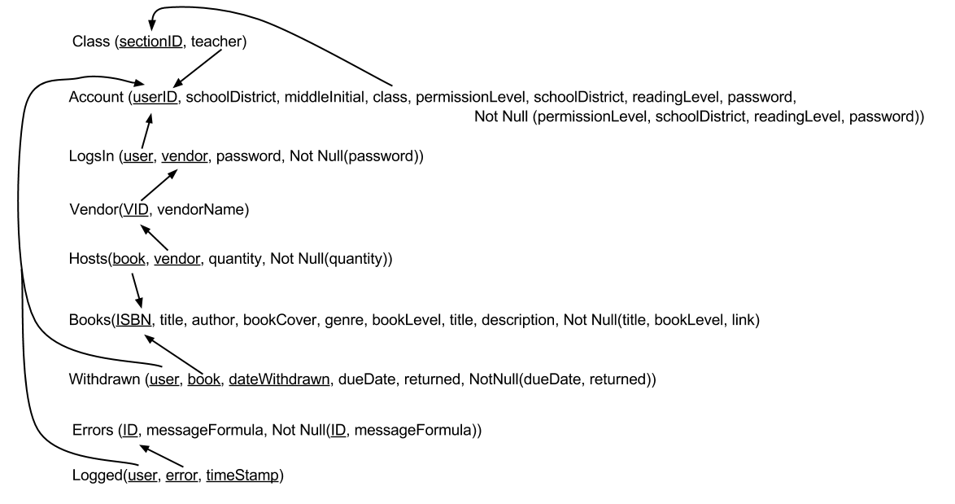
Database Schema

Slide 17
Testing Plan
Unit Testing: Each function tested separately
Integration Testing: Tested between units
System Testing: Satisfies Requirements Inventory
Performance Testing: Stress Testing System
Acceptance Testing: Final Product

Slide 18
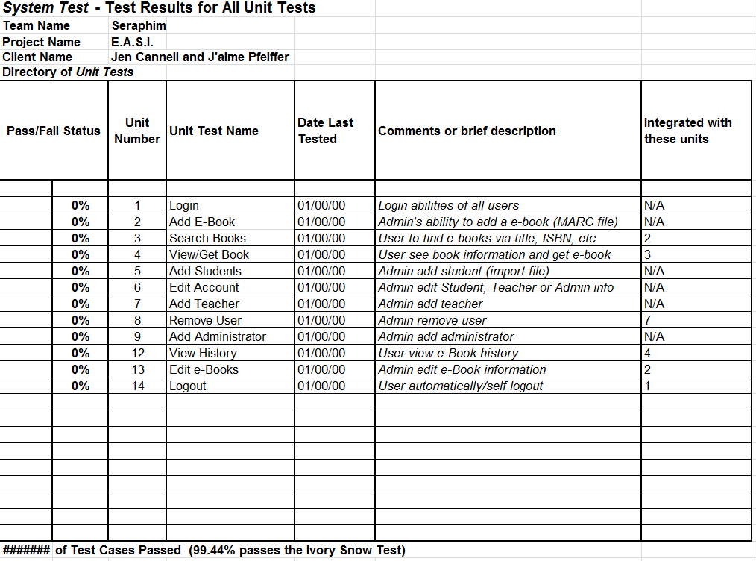
Unit Tests - Directory

Slide 19
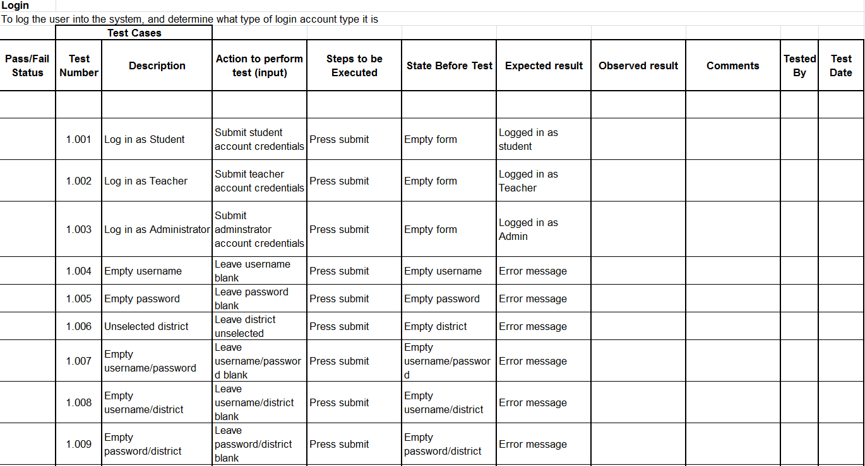
Unit Test - Login

Slide 20
Unit Test – Login (cont.)

Slide 21
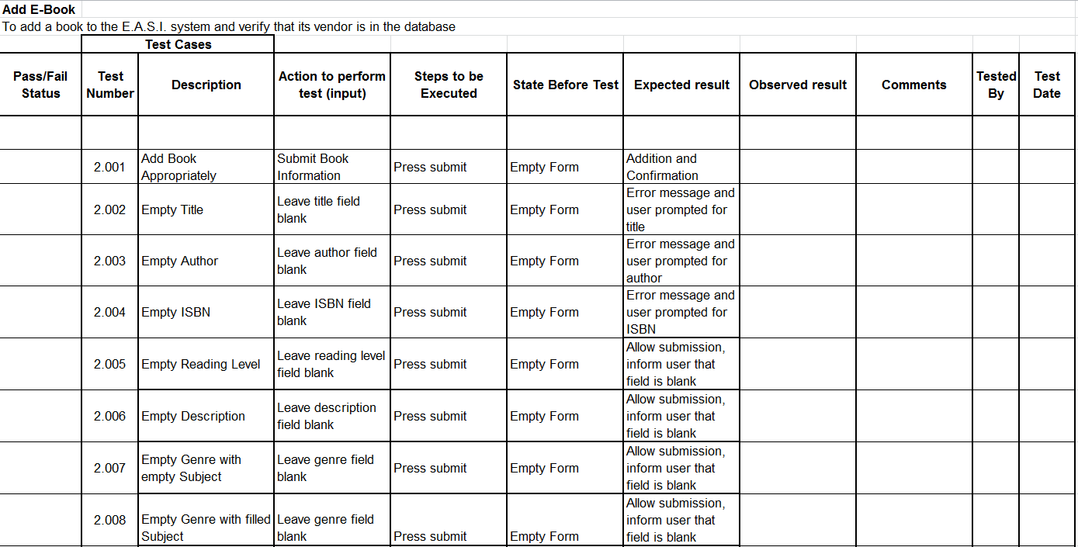
Unit Test – Add Book

Slide 22
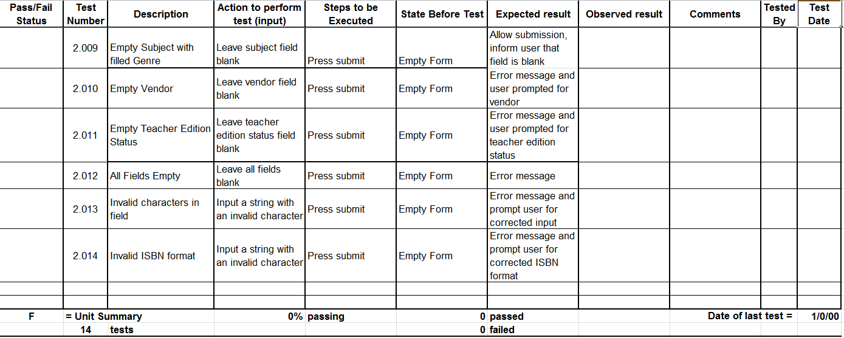
Unit Test – Add Book (cont.)

Slide 23
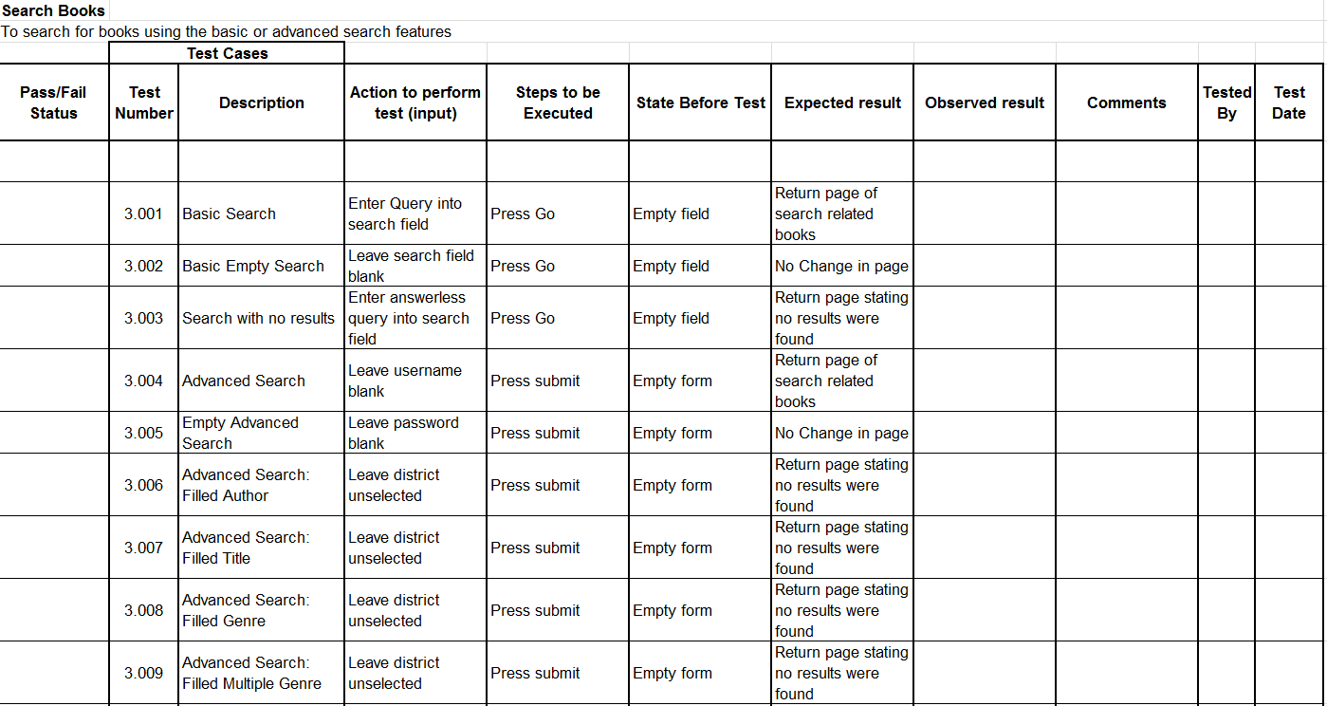
Unit Test – Search Books

Slide 24
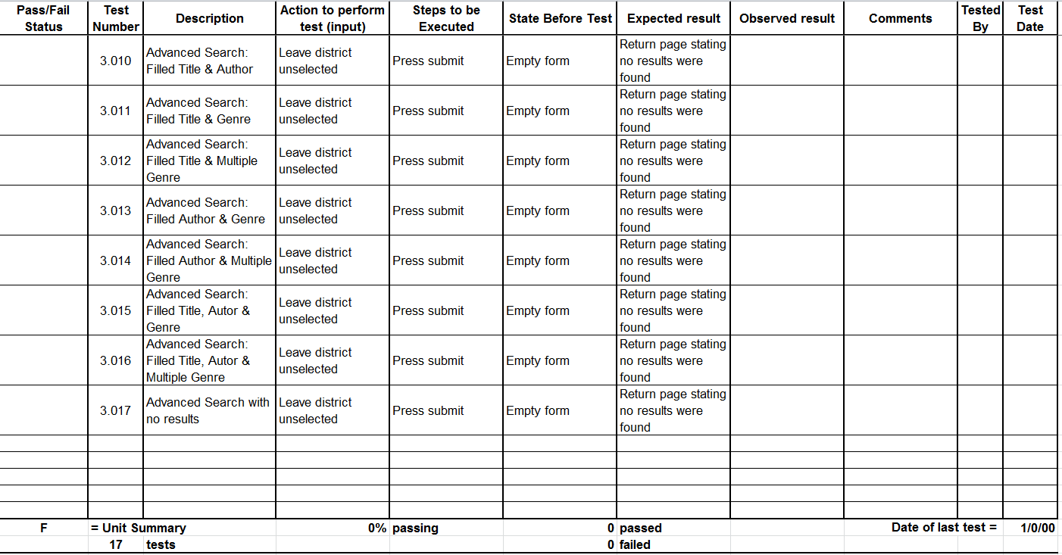
Unit Test – Search Books (cont.)

Slide 25
Unit Test – View/Get Book

Slide 26
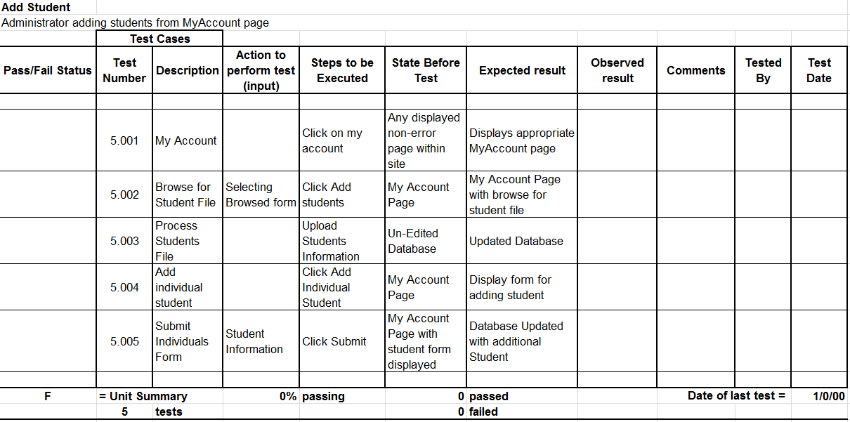
Unit Test – Add Student(s)

Slide 27
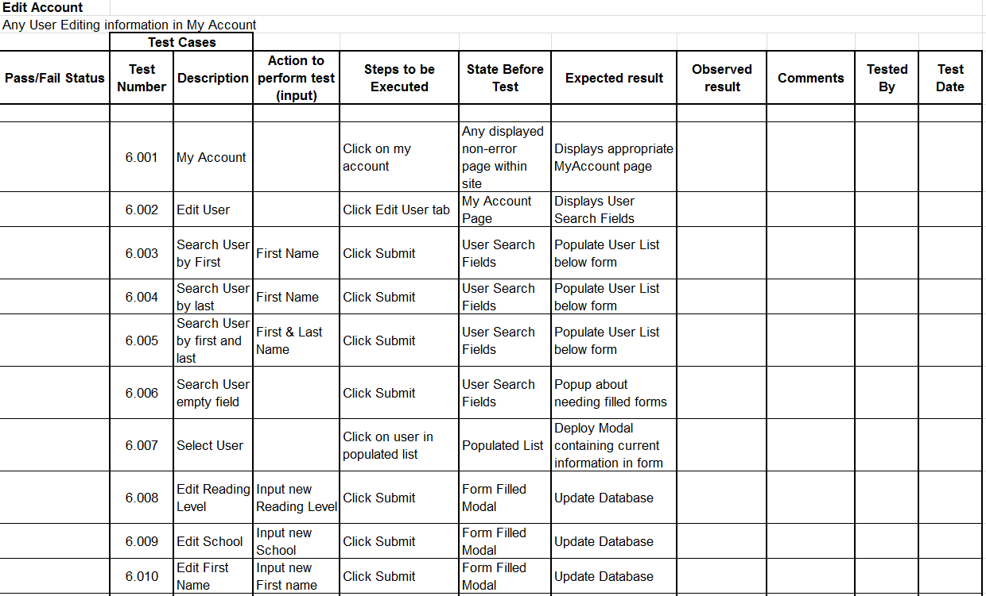
Unit Test – Edit Account

Slide 28
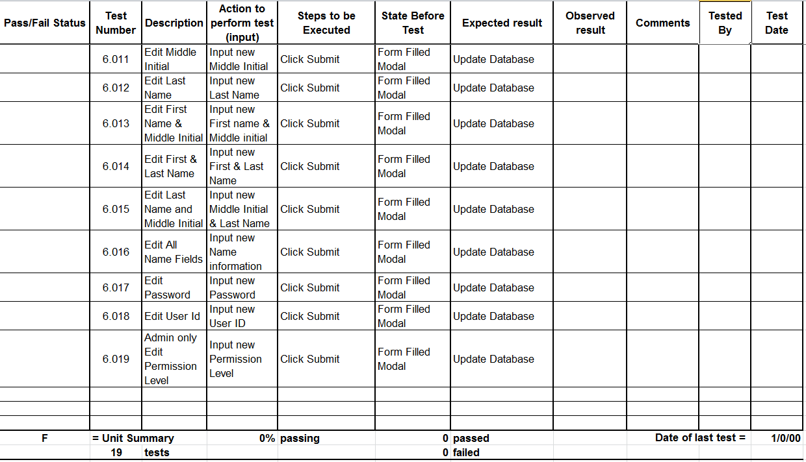
Unit Test – Edit Account (cont.)

Slide 29
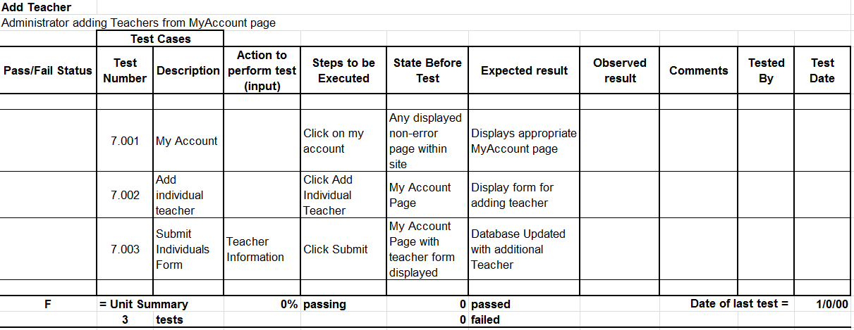
Unit Test – Add Teacher

Slide 30
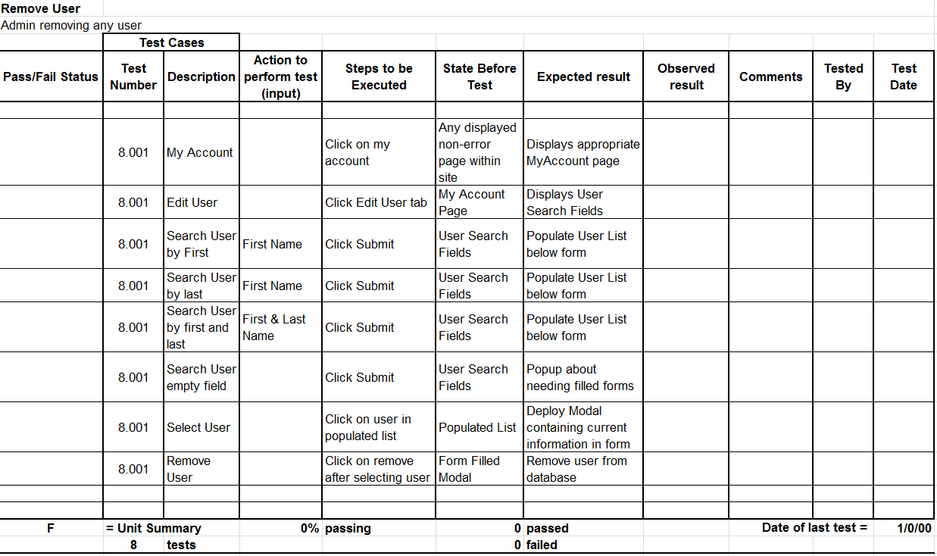
Unit Test – Remove User(s)

Slide 31
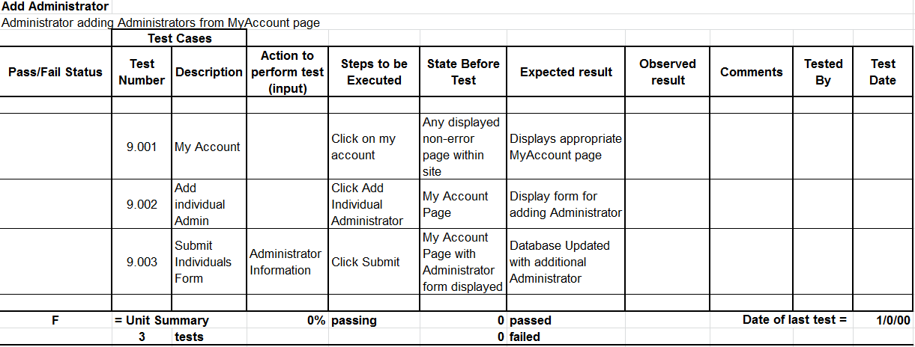
Unit Test – Add Administrator

Slide 32
Unit Test – View History

Slide 33
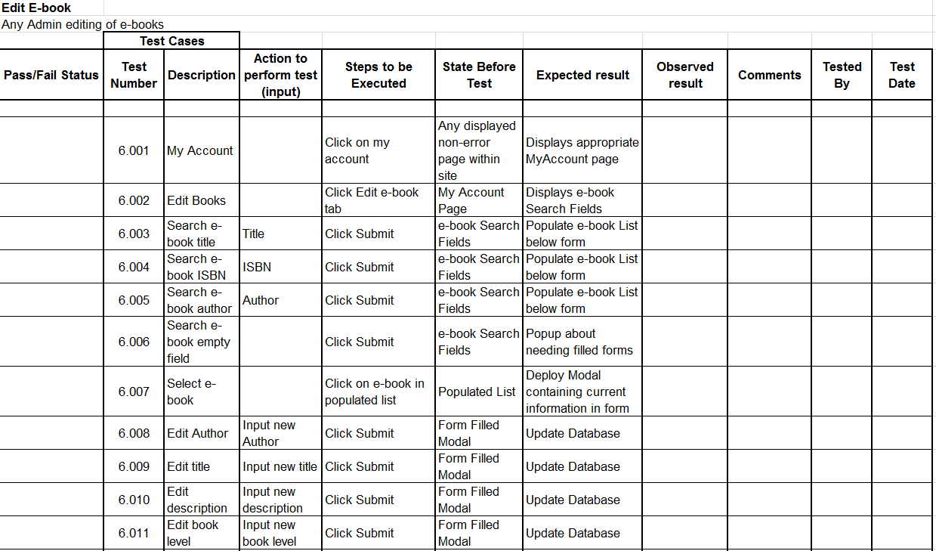
Unit Test – Edit e-Book(s)

Slide 34
Unit Test – Edit e-Book(s) (cont.)

Slide 35
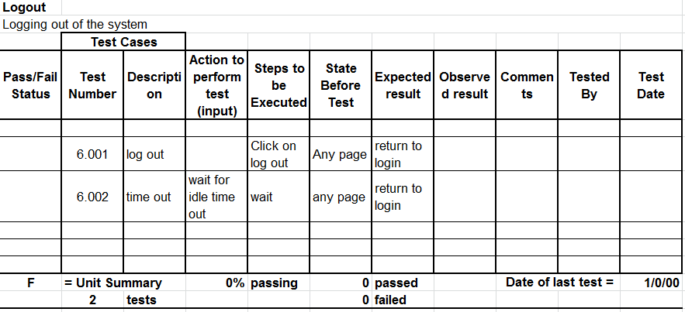
Unit Test – Logout

Slide 36
E.A.S.I. Prototype

Slide 37
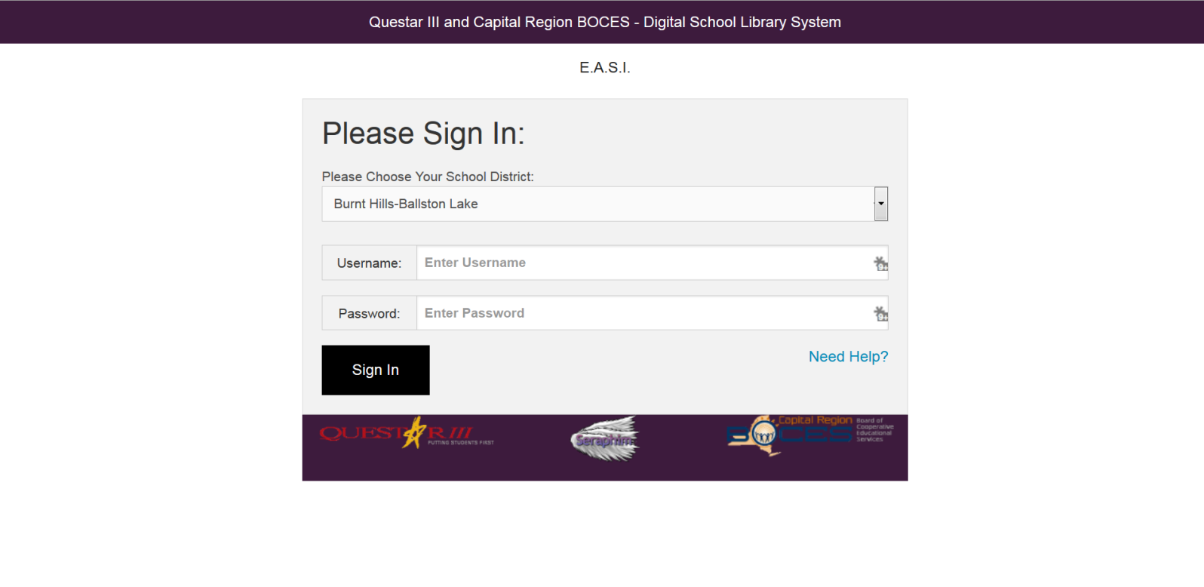

Slide 38
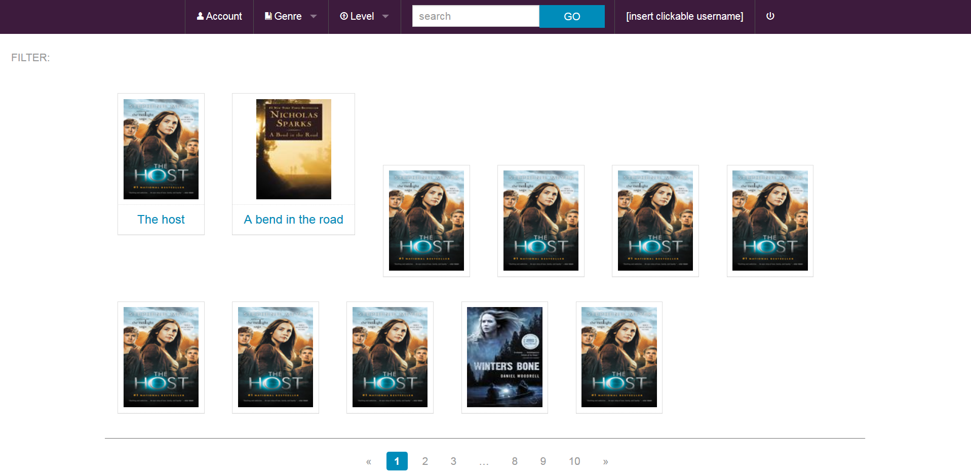

Slide 39
Timeline

Slide 40
What’s Next?
Prototype – MARC File Integration, My Account
Acceptance Test
Revamp Seraphim Website
Team Song
Academic Celebration (4/24/15)
Kill the Dragon!!!

Slide 41
Questions?

Slide 42
Agenda
System Definition
Overview & Life Cycle
Project Plan
Entity-Relationship Diagram
Unit Tests
Prototype
Review Diagram Changes
Database Dictionary
Database Schema
Testing Plan
What’s Next

